Slide 1
HSAs: Give Yourself Control Over Healthcare Spending
Company Logo
Notes:
Use this template for a co-branded presentation. Delete the “Company Logo” text box and insert either a jpeg or png of your company’s logo.

Slide 2
Agenda
What is an HSA?
Why an HSA?
Three ways to use an HSA
How to enroll and get started
Lively HSA features
Notes:
Health Savings Accounts, or HSAs, can be a valuable addition to your savings plan. Today we will cover the basics—what is an HSA, why you might want to choose an HSA, three great ways to use the account, how to enroll, and key features of Lively’s HSA. Lively is the partner we chose to administer our company’s HSAs.

Slide 3
1
What is an HSA?
Disclaimer: the content presented here is for informational purposes only, it is not investment, legal, accounting, or financial planning advice, nor a recommendation as to a specific course of action. Investors should consult all available information, including fund prospectuses, and consult with appropriate investment, accounting, legal, and accounting professionals, as appropriate, before making any investment or utilizing any financial planning strategy.
Notes:
Let’s get started. First, you’re probably wondering, What is an HSA? Let’s get that answered.

Slide 4
What is a Health Savings Account (HSA)?
An HSA gives you personal control over how you save and pay for your healthcare expenses.
Specialized bank account just for healthcare expenses
Designed to pair with an HSA-qualified health plan
Save and pay tax-free for out-of-pocket expenses
Notes:
An HSA is a specialized savings account designed to give you personal control over how you save and pay for healthcare expenses. Deposits to HSAs are tax free, and when you pay for out-of-pocket healthcare expenses with your HSA, you’re using funds that you didn’t pay taxes on, helping you save money.

Slide 5
How an HSA works with your health plan
Preventive Coverage
Insurance pays 100%*
Covered Services
You pay 100%
You & insurance
share the cost
You pay $0
Deductible
Co-insurance
Out-of-pocket max
Pay with your HSA
*Check with your employer or health plan for details on what’s included
Notes:
HSAs complement the <health plan name> that you can choose during open enrollment. Here’s how an HSA works with the plan and the various portions of expenses that you may have.
First, preventive care is covered at 100%--meaning there’s no cost to you for these services. These services include things like annual physicals, well-woman and well-baby care, annual health screenings, and more. Second, the <health plan name> comes with an upfront deductible. This is like the deductible on your car insurance--money you have to pay first before the insurance covers a portion of your costs. You can use the funds in your HSA to cover your deductible expenses.
Once your deductible is met--assuming you have enough costs in a given year to reach your deductible, and many of us don’t--the co-insurance portion of the plan starts. Co-insurance is basically cost sharing with insurance. Generally speaking, you’ll owe a percentage of any medical service you receive. For our plan, the in-network amount is <co-insurance percentage>. As an example, let’s say you see the doctor and the bill is $100. You’ll only owe <$XXX>--that’s <X%> of $100. Just like your deductible, you can pay co-insurance expenses with your HSA as well.
Finally, your health plan comes with an annual out-of-pocket limit. This is the maximum amount you’ll have to pay in any given year for medical costs. Once you reach this amount, you won’t owe any more money for medical costs that year.

Slide 6
2
Why an HSA?
Notes:
Next let’s talk about why you might want an HSA.

Slide 7
HSAs have many meaningful benefits
Did you know?
An HSA is the most tax-advantaged savings account available in America.
Tax-free contributions, interest, and spending on qualified expenses
Pay for everyday healthcare expenses for you and your family
Funds never expire. Use them anytime today through retirement
Notes:
HSAs are the most tax-advantaged accounts in America. This means they come with a number of meaningful tax benefits. First, your HSA deposits are pre-tax when made through payroll at work. Second, any gains in your HSA are free of federal taxes. And third, when spending on qualified expenses, funds come out tax-free. So you never have to pay tax on money into and out of your HSA, as long as you use it on qualified expenses. More on those in a minute.
What’s even better is you can use the funds in your HSA on your own expenses, plus those of your family--even if they aren’t covered by your health plan.
Finally, the funds never expire. You own your HSA and the funds in it, and unlike an FSA, you can spend the funds anytime--today, all the way through retirement. They never expire! So if you don’t have a lot of healthcare expenses today, you can save them for tomorrow, risk free.

Slide 8
3
Three ways to use your HSA
Notes:
Now let’s talk about 3 popular ways people use HSAs.

Slide 9
Three popular ways to use an HSA
HSAs have incredible flexibility. Whether you have medical costs today or do not, your HSA is a valuable tool to save you money.
Get a discount on today’s healthcare expenses
Build a safety net for tomorrow’s costs
Prepare for retirement
Notes:
You can benefit from an HSA whether you have healthcare expenses today, or not. The first way to use an HSA is to reduce today’s out of pocket healthcare expenses. It’s like giving yourself a discount on today’s costs. if you don’t have many costs today, use your HSA to prepare a safety net for future or unexpected costs. Unfortunately we all eventually have healthcare expenses, and your HSA can be a great way to get ready. Finally, you can use your HSA to save for retirement.
Now let’s look in more detail at how each of these work.

Slide 10
Pay up to 35% less for today’s expenses
WITH YOUR HSA
$100 to spend
What Qualifies?
✓
✓
Doctors | Dentist
Specialists | Chiropractor
Prescriptions | Acupuncture
Hospitalizations | Therapist
Lab Work | OTC Medications
Eye Doctor | Medical Supplies
✓
✓
✓
✓
WITHOUT AN HSA
$65 to spend
✓
✓
✓
✓
✓
✓
Not sure something qualifies? Find out what’s eligible at livelyme.com/whats-eligible.
*Your savings may vary. 35% example includes 24% federal tax savings, 7.65% payroll tax savings, and 3.35% state tax savings. Payroll tax savings are only available on deposits made through payroll. State tax savings are not available in states without income taxes or in California or New Jersey.
Notes:
HSAs are the ticket to discounts on today’s healthcare costs. How? Thanks to the tax savings you get for every dollar deposited to your HSA, when you make payments from your account you are paying less than you would if using income that’s been taxed. I have an example of this on the next slide.
But first, you’re probably wondering what qualifies for payment from your HSA. And the list is really big! it includes medical expenses that are subject to your health plan deductible--things like doctor visits, prescriptions, and hospitalizations. it also includes out of pocket expenses at the dentist, optometrist, chiropractor, or mental health therapist. Even things like ibuprofen and other over the counter drugs, bandages, and medical supplies all qualify for payment from your HSA.
To see a complete list, visit Lively’s eligible expense tool and you can search for every possible qualified expense.

Slide 11
How do the tax savings work?
Federal Tax
$1,107
+
=
Payroll Tax
$353
State Tax
$155
With your HSA $3,000 in out-of-pocket expenses costs you $3,000.
You saved $1,605 in taxes* on the income used to pay these expenses.
Without an HSA, $3,000 in expenses would cost you $4,605 of income
*Your tax savings may vary. 35% tax savings assumes 24% federal, 7.65% payroll, and 3.35% state tax. State tax savings are not available in CA or NJ or states without an income tax. Talk to your tax advisor for insight on your savings potential.
Notes:
So how do those tax savings work? Here’s an example. Let’s say that you have $3,000 in out of pocket expenses annually. When paying from your HSA, that costs you $3,000 of income because you deposited those funds pre-tax.
Without an HSA, those same $3,000 in expenses would actually cost you $4,605 of income, assuming total taxes of 35%. Here’s how. To get $3,000 of take home pay, you actually paid over $1,100 in federal tax, another $350 in payroll tax, and over $150 in state income tax. When depositing funds into your HSA, you get to skip all those taxes!
Keep in mind this is an example, and your tax savings may vary. But it gives you a good idea of how much you can save with your HSA.

Slide 12
Build your healthcare safety net
Don’t have too many expenses today or not sure what HSA savings target to set for this year?
Here are a few safety net savings strategies:
What you spent last year, plus extra to save | If you have costs, contribute what you spent last year plus more to begin a carryover balance.
Upcoming medical costs | Save enough to cover upcoming healthcare costs like a procedure or pregnancy.
Your health plan’s deductible | Set a goal to save enough in your HSA to cover your annual deductible.
Your out-of-pocket max | Cover your out-of-pocket limit. That’s the most you’d be on the hook for in any given year.
Notes:
Not all of us have a lot of healthcare expenses today, but probably will someday. Building a safety net in your HSA is another popular way to use the account.
Think about seeing a savings goal for your HSA. if you have costs today, save a little extra to begin a balance you carry over to next year. Planning an upcoming procedure or family? You can save for that tax-free.
Finally, think about covering your maximum annual health plan limits. First save enough to cover your deductible, or better yet your out of pocket limit--the most you’d pay in a given year.

Slide 13
How much could you save in your safety net over time?
Annual Contributions | HSA Balance* |  |  | Potential Total Tax Savings**
 | 5 Years | 10 Years | 20 Years | 5 Years | 10 Years | 20 Years
$1,000 | $5,000 | $10,000 | $20,000 | $1,750 | $3,500 | $7,000
$2,500 | $12,500 | $25,000 | $50,000 | $4,375 | $8,750 | $17,500
$5,000 | $25,000 | $50,000 | $100,000 | $8,750 | $17,500 | $35,000
$7,200 | $36,000 | $72,000 | $144,000 | $12,600 | $25,200 | $50,400
*Assumes all funds are saved each year and none are spent.
**Total tax savings of 35% used in this example. Your savings may vary.
Notes:
This chart gives you an idea of how much you could save over time. $2,000 a year is just over $200 a month. $1000 a year is less than $100 a month. If you start saving early, you can have a nice safety net sooner than you think. Plus on the right you can see your total potential tax savings--that’s extra money you are saving as part of your balance, rather than lost to taxes.

Slide 14
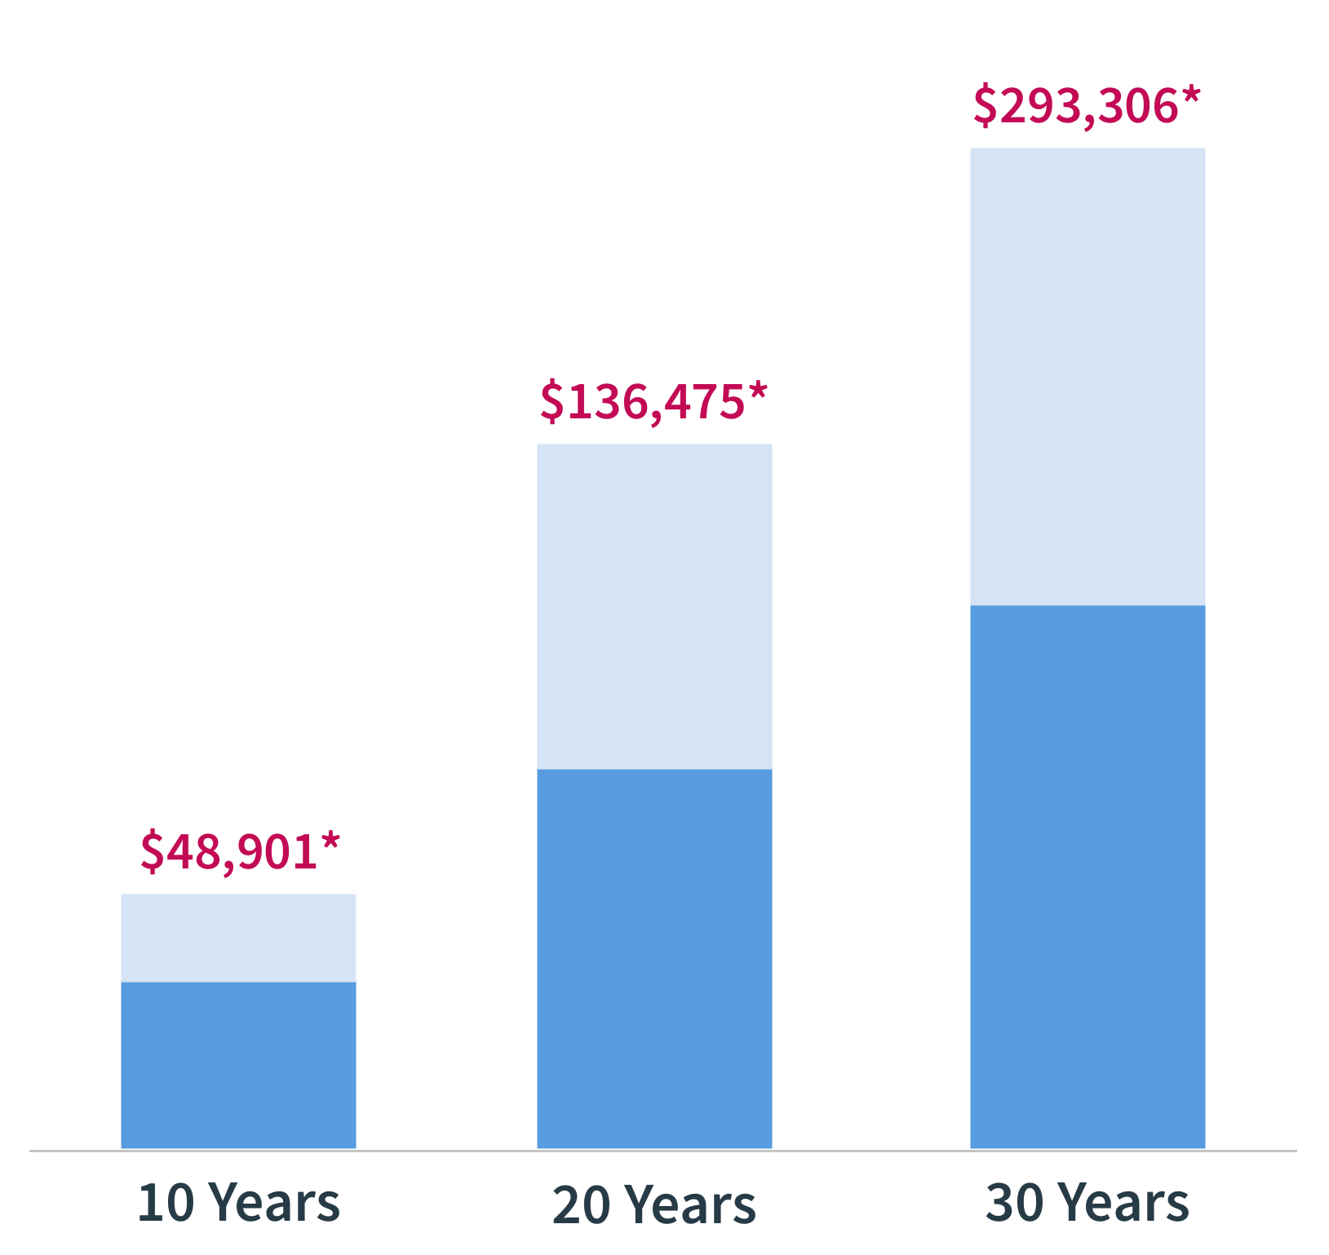
Use your HSA to prepare for retirement
✓
You can invest in your HSA. Think of it like a a 401(k) for healthcare
✓
You have the flexibility to use the funds anytime—today through retirement
*Assumes $3,500 is invested within your HSA each year. Potential returns for 10, 20, or 30 years assume a 6% annual return. All returns and principal remain invested each year. Investments are not guaranteed, not insured, and may lose value.
Notes:
We just saw the savings potential of the account without investing, but HSAs also have the option to invest, just like a 401(k). Many retirement professionals consider them the 401(k) for healthcare--a great way to prepare for the $295,000 the average couple will need for healthcare expenses in retirement beyond what Medicare covers, per Fidelity. The biggest differences between HSAs and 401(k)s? With an HSA you can use the funds anytime between now and retirement, and your withdrawals for qualified expenses are always tax free. You can’t get funds out of your 401(k) tax free, and you have to wait until you’re nearly 60 to start using them.
Adding in the growth potential of the stock market, this chart shows how much your account could grow by in 10, 20, and 30 years. The assumptions with these returns is you invest $3,500 per year in your HSA and never pull funds out. With a hypothetical return of 6% per year, you could have nearly $50,000 saved after 10 years, over $135,000 after 20, and nearly $300,000 after 30. Remember, investing is not guaranteed, not insured, and you could lose money.

Slide 15
4
How to enroll & get started
Notes:
Be sure the number these section pages to match up with your Agenda/Table of Contents
Ok, that was a lot of potential benefits! Now let’s talk about enrollment and how to get started with an HSA>

Slide 16
Eligibility requirements
Enroll in the <plan name> health plan during open enrollment
You cannot be covered by another health plan or a general-purpose Flexible Spending Account (including a spouse’s FSA)
You cannot be claimed as a dependent on someone else’s tax return
You cannot be enrolled in Medicare (Part A or B) or Medicaid
Not everyone qualifies for an HSA. Here are the requirements to enroll.
✓
✓
✓
✓
Notes:
There are eligibility requirements to own an HSA. Let’s get started with those.
First, you must be enrolled in the <health plan name> at <company name> to open and HSA. No other plans we offer qualify.
Second, you can’t be covered by another health plan or an FSA--such as your spouse’s--and there are special restrictions if you have VA benefits. If you do, please talk to HR. You also can’t be enrolled in Medicare, nor can you be claimed as a tax dependent on someone else’s tax return.

Slide 17
Deciding how much to contribute
Your contribution election is a key part of the process for setting up your account.
Setting a recurring contribution through payroll is one of the best financial decisions you can make because your balance will grow with no additional action needed.
Who’s the Coverage for? | Annual Contribution Limit (2024) | Your Employer’s Contribution
You Only (Individual) | $4,150 | $0
You +1 or more (Family) | $8,300 | $0
If 55 or older in 2024 | $1,000 extra (catch-up contribution)
NOTE: Remember to edit the Employer Contribution information accordingly. If you are not contributing to your employee’s HSA, remove the last column in this chart.
Notes:
If you do qualify, and decide to enroll in the <health plan name> health plan, the next big decision is how much to contribute. Remember, your funds never expire and can always be spent tax free on qualified expenses, even if you leave <company name> or change health plans. So plan your contribution knowing you’ll always be able to spend the funds in the future.
With that in mind, you’ll be able to set your paycheck election--the amount you’ll contribute to your HSA per pay cycle pre-tax--during enrollment. The first thing to know is there are annual contribution limits. For 2022 the limits are $3,650 per year if your health plan covers you only, and $7,300 if it covers you plus at least one more person. Additionally, if you will be 55 or older anytime in 2022 you can make an extra $1,000 catch-up contribution.
And here’s some good news! <company name> will contribute $<amounts> to your HSA at the beginning of the year <change if your company’s contribution timing is spread throughout the year>. That’s free money we are giving to you to help prefund your HSA and ensure you have funds in it if you need them when the plan year starts.

Slide 18
Choose your election amount
Tips for Finding Extra Funds to Save:
Deposit premium savings from lower cost plan
Transfer from another HSA
Make a one-time IRA transfer
Better budgeting: cancel unused subscriptions and unused apps
✓
Decide how you’ll use the account: spending today, long-term saving, max contribution
Try Lively’s savings calculator to see how much you can save by contributing to an HSA here
View Lively’s Contribution Guide for guidelines on setting election here
✓
✓
NOTE: If your company has legacy HSAs to transfer to Lively, highlight the process/steps for the transfer on this slide by replacing the “Tips for Finding Extra Funds to Save” section with the transfer details
Notes:
When thinking about your election amount, here are a few things to think about.
How will you use the account? To pay just for this year’s expected expenses, a mix of spending and saving, or trying to max out long-term savings? Lively offers some great tools to help you decide, including an optimal savings calculator and a Contribution Guide.
Next, here are a few tips for finding extra money to save. First, think about saving the premium difference between our health plan offerings in your HSA. Rather than taking home more pay, simply take those savings from each pay cycle and add them to your HSA. Second, if you have another HSA, you can transfer it tax free to Lively. Third, if you have an IRA, you are allowed to do a one-time tax free transfer, subject to your annual contribution limit, into your HSA. Finally, think about better budgeting and make some trade offs. Could find recurring subscriptions or apps that you no longer use, and channel those savings into your HSA?

Slide 19
Comparing plans: the effective deductible
 | [Non-HSA Plan Name] |  | [HSA Plan Name]
 | Single | Family | Single | Family
Annual Premium | $2,400 | $6,400 | $1,200 | $3,600
Deductible | $1,000 | $2,000 | $2,500 | $5,000
Employer HSA Contribution | - | - | $500 | $1,000
Annual Premium Savings | - | - | $1,200 | $2,800
Combined Savings (Employer contribution and premium savings deposited into HSA ) | - | - | $1,700 | $3,800
Effective Deductible | $1,000 | $2,000 | $800 | $1,200
NOTE: Update plan names and numbers on this slide to match your plans.
If more than two plans, add additional columns.
Notes:
Need some help comparing our health plan options? Lively has created the concept of the Effective Deductible, which gives you a better comparison of deductibles across plans. Here’s how it works:
First, let’s look at the premiums for our health plan options. As you can see, the premium--the portion of the cost of the health plan that you pay--for the <health plan name> is lower than that of our other plan options. That’s less money coming out of your paycheck each month.
Next, let’s look at the deductibles for our health plan options. As you can see, the deductible for the <health plan name> is higher than that of our other plan options. That’s the trade off--you pay less to the insurance company each month, but you are responsible for more cost out of pocket.
On the next line, you can see the contribution we will be making into your HSA next year. Once again, that’s free money we are giving to you.
The annual premium savings is the amount you save when choosing the <health plan name>, and the combined savings is the combination of premium savings and our company contribution to your HSA. if you were to take your premium savings and add them to your HSA along with our company contribution, that’s free money in your HSA that didn’t cost you anything.
Now look at the last line. if you subtract those total savings from the deductible on the <health plan name>, you can see the portion of the deductible that you would need to come up with, if you have a lot of medical expenses in a given year. See how that amount compares to the deductible on our other plan options and it gives you a better comparison of what you’d need to pay. Of course if you don’t have too many expenses in a given year, you get to pocket those savings in your HSA for future expenses.

Slide 20
Get enrolled
1
Open enrollment runs from <date> to <date>
3
Enrollment instructions <customize with instructions specific to your company>
2
Be sure to set your election when enrolling. <Company name> will contribute $<single amount> or $<family amount> to your HSA
4
Check your email
Finalize account by following the steps in an email from Lively
Notes:
Here’s how to enroll. <please customize this section based on your company’s details>.

Slide 21
What to expect after you enroll
1
Look for your debit card in the mail 1-2 weeks before our health plan start date of <plan start date>. Be sure to activate it immediately.
2
Out-of-pocket qualified expenses can be paid with your HSA beginning on <plan start date>.
3
Your initial HSA contribution will be deposited into your HSA within a couple days of the <payroll date> payroll cycle.
Notes:
Once you complete enrollment, here’s what to expect. Look out for your Lively HSA debit card, which should arrive in the mail 1-2 weeks prior to <health plan start date>, our health plan start date.
Beginning <health plan start date>, any eligible expense can be paid with your HSA. Your initial paycheck contribution to your HSA will take place within a few days of <date of first payroll in following year>, the first payroll date next year.

Slide 22
5
Features of Lively HSA

Slide 23
Spending from your HSA
Your HSA debit card is the safest and most convenient way to pay with your HSA.
If you pay for qualified expenses out of pocket, reimburse yourself from your HSA.
Add your debit card to your mobile wallet for even more convenience
You can pay yourself back for qualified purchases anytime in the future
Each time you pay from your HSA, upload receipts to your Lively dashboard
Notes:
We just mentioned your HSA debit card, which is the easiest and safest way to pay from your HSA. You can add your card to your mobile wallet for even easier payments.
What happens if you don’t have the funds in your account when you need to pay? That’s ok. You can always pay out of pocket, wait until you build up enough tax-free funds built up in your account, and then reimburse yourself anytime in the future. That way you still benefit from the tax savings on your expense.
Each time you do have an expense, be sure to save your receipt. Although you don’t need a receipt to prove an expense was qualified when you first pay it, the IRS requires that you save detailed receipts for payments from your HSA. If you are even audited, the IRS will ask for proof the expense was qualified. Lively makes it easy for you to upload your receipts and save them with the transaction record on Lively’s HSA dashboard.

Slide 24
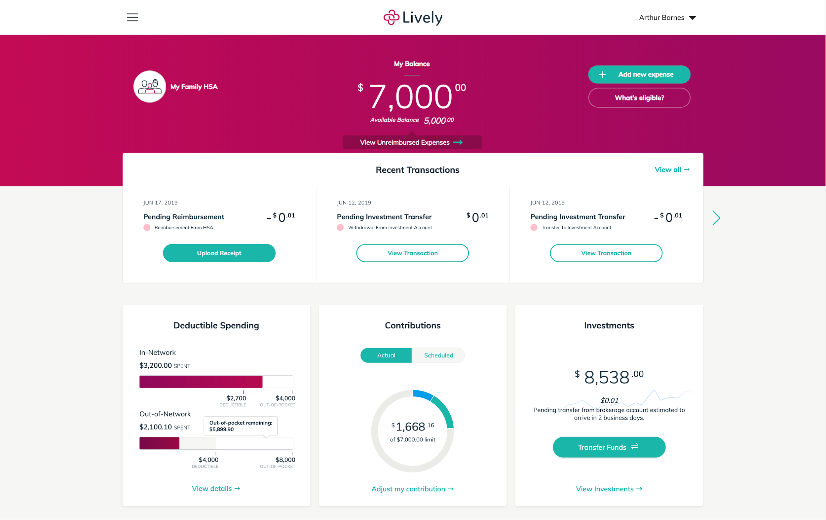
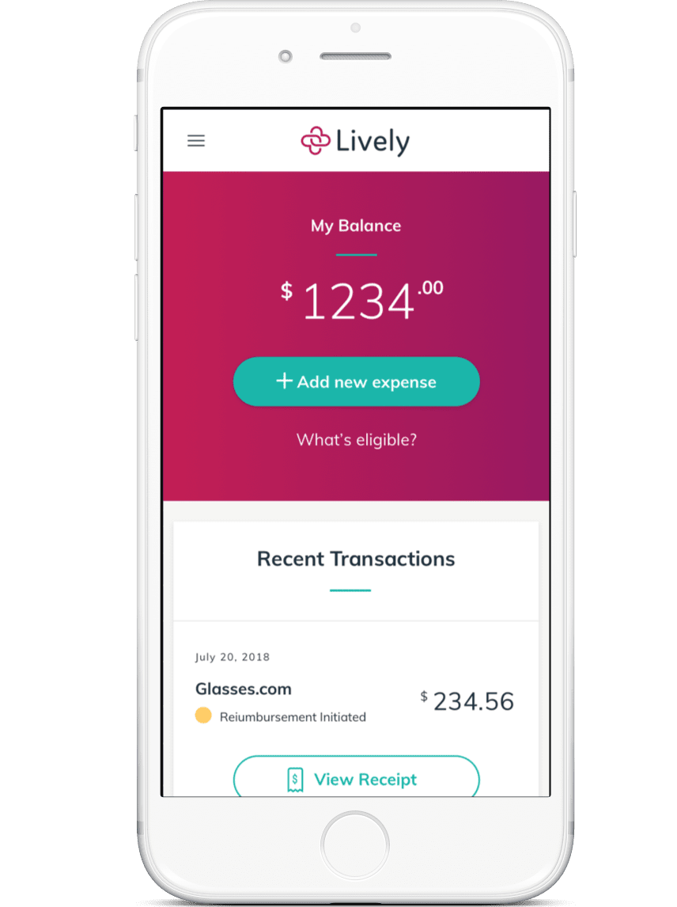
Manage accounts effortlessly, even while on the go
Lively Dashboard
Mobile App
Notes:
Your Lively dashboard is the online hub for managing your HSA. When completing the enrollment process you’ll create your credentials to sign onto your account. This will give you instant access anytime you want to check your balance, move money, make investments, or save receipts.
Lively also offers a mobile app you can download once you’ve signed up. The mobile app offers the same account management functions right from your cell phone or tablet.

Slide 25
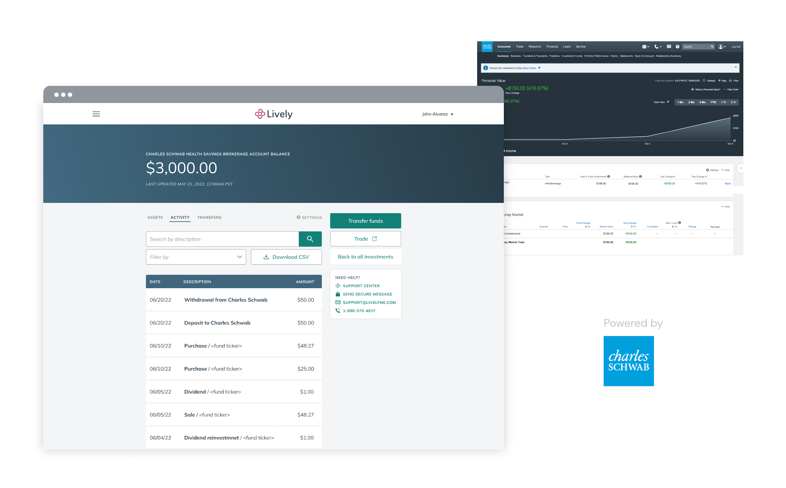
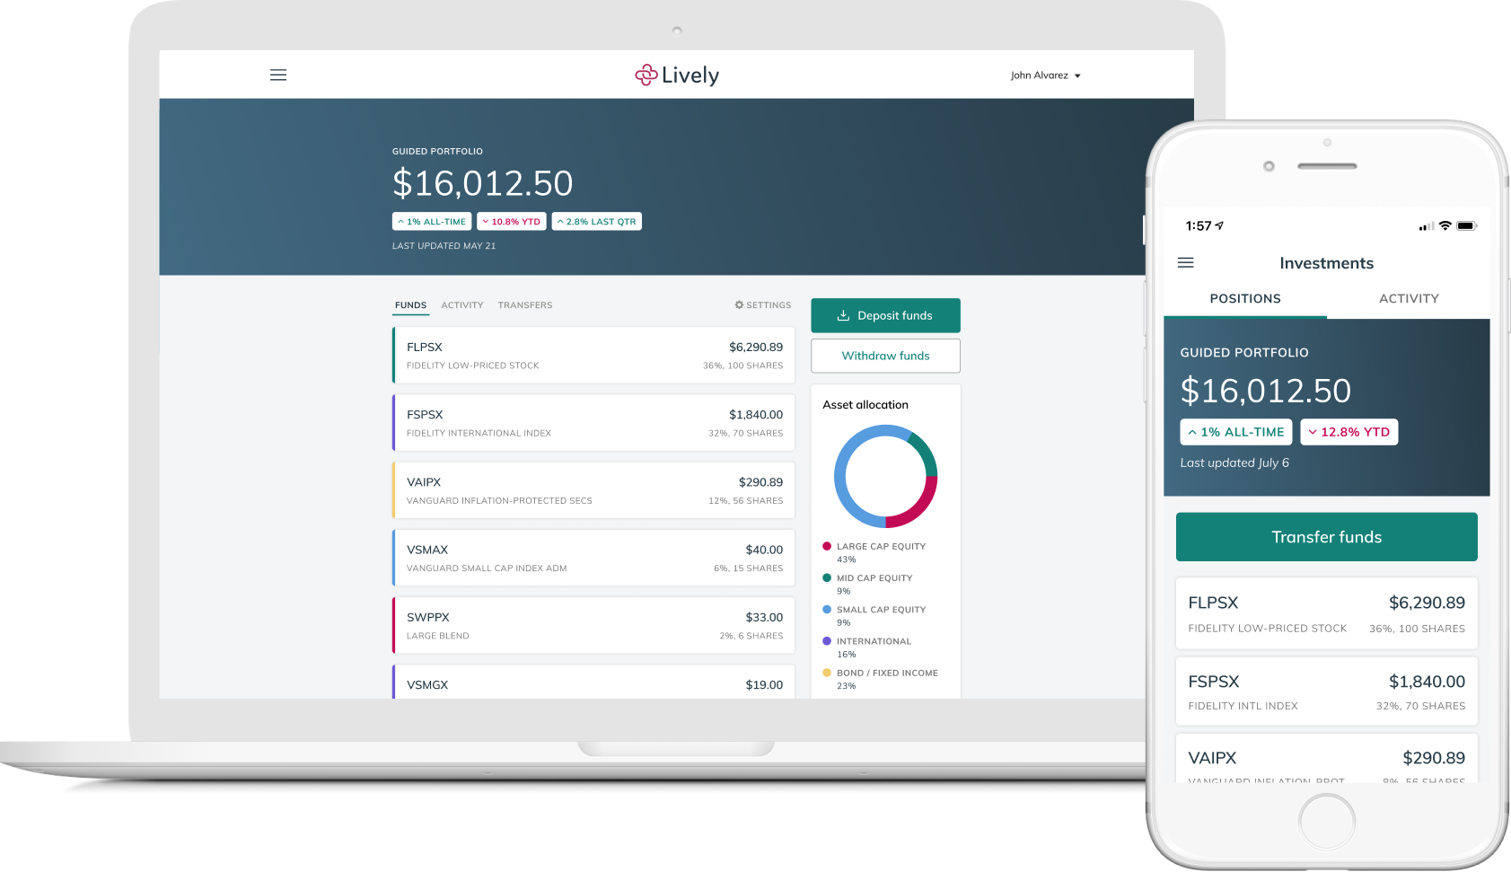
Robust, personalized investment solutions
HSA Guided Portfolio
Schwab Health Savings Brokerage Account
Personalized suggestions tailored to your risk preferences and time horizons with a high-quality, low-cost funds.
Automatic rebalancing helps ensure the portfolio stays on track over time
0.50% annual fee based on invested assets.
Access a wide range of investment options to build your ideal portfolio, including stocks, blonds, mutual funds, and ETFs.
Choose to invest with no minimums after a $24 annual fee from Lively or invest anything above $3,000 in your cash balance for no fee from Lively.
Notes:
The potential of tax-free investment growth is one of the most valuable benefits of owning an HSA. Lively offers access to two personalized solutions to help you make your money go further.
Regardless of what your investment strategy is, you have easy access to industry-leading solutions to help you design your ideal portfolio. You choose when and how much to invest, to best fit your financial strategy.

Slide 26
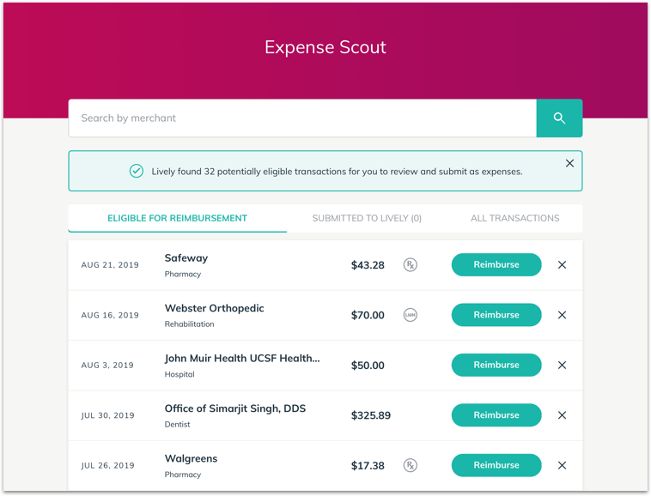
Tools to help you maximize your HSA
Once your account is setup and ready to use, log into your Lively Dashboard and enable these features:
Deductible Tracker – Connect your health plan and track spending against your deductible. Automatically updates with your in and out-of-network spending
Expense Scout – Automatically catch eligible expenses you may have missed. Securely link external accounts and cards and Expense Scout will identify potential eligible expenses for you to review and accept or reject for reimbursement.
Reimbursable Bank – Choose whether you want to be reimbursed now or later
Notes:
Lively also offers a few extra features to help you get the most out of your HSA.
First, their Deductible Tracker allows you to connect your health plan directly to Lively so you can see your spending progress against your deductible, with both in and out of network spending.
Expense Scout is a great tool for finding every possible eligible expense so you maximize your savings. you can link external bank accounts and credit cards and Expense Scout will identify potential eligible expenses you may have missed so you can reimburse yourself for everything that qualifies.
Finally, link your external bank account to Lively and use the Reimbursable Bank feature to reimburse yourself for out-of-pocket payments. It’s your choice--pay yourself back today, or wait and do it anytime in the future.

Slide 27
Q&A
Notes:
That brings us to the end of the presentation. Are there any questions I can help answer?

Slide 28
Appendix

Slide 29
Common healthcare terms
Term | Definition
Premium | Your portion of the monthly cost of your health plan.
Preventive care | Annual no-cost services that help you stay healthy: physicals, well-woman, well-baby, immunizations, and medical screenings.
Deductible | The annual amount you pay before your health plan pays a portion.
Co-insurance | A percentage you pay for services after your deductible is paid.
Co-payment | A flat fee you pay for services after your deductible is paid.
Claim | A claim is submitted to insurance each time you use services, which then determines who pays for the service, and how much.
Out-of-pocket limit | The annual limit for your share of costs; anything above this amount is paid 100% by your insurance company.
Formulary | The list of prescription drugs covered by your health plan.
In-network | Doctors that are in-network have a contract with your health plan to perform services at an agreed-upon price.
Out-of-network | Doctors that are out-of-network do not have a contract with your plan and are typically more expensive then in-network doctors.
Notes:
If you think your team can benefit from an overview of key healthcare terms, add this slide to your presentation.

